Slide 1

Giving it a Voice

Slide 2
Objectives
Discuss the pros and cons of various voice chatbot options
Understand how Watson Speech APIs work
Voice Chatbot

Slide 3
Voice chatbot
Some use cases call for text-based interfaces, and some for voice-based interfaces.
Voice-based interfaces are more intuitive and easy to use, compared to their text-based counterparts
Speech is a communication ability that humans have had for over 1.3 million years whereas written language has only been around for about 6,000 years.
Voice Chatbot

Slide 4
Voice chatbot
Implementing a voice-based interface for Watson Assistant chatbots, there are three approaches.:
  Making the chatbot available through phone calls- implementing the solution yourself.
  Implementing an application that leverages Watson Speech to Text and Text to Speech APIs.
  Making the chatbot available through the phone, relying on the easy integration offered by the Voice Agent with Watson service
Voice Chatbot

Slide 5
Voice chatbot
What are the pros when using phone calls as an interface for Watson Assistant
  Easily accessible
  No downloads required
What are the cons when using phone calls as an interface for Watson Assistant
  From scratch implementation
  Low flexibility
Voice Chatbot

Slide 6
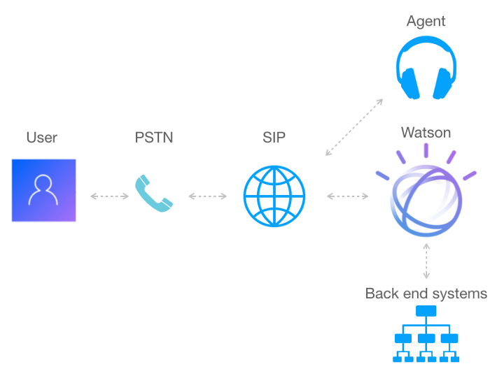
Voice chatbot
Voice Chatbot

Slide 7
Voice chatbot
What are the pros when using Watson Speech APIs as an interface for Watson Assistant
  Very customizable and flexible
What are the cons when using Watson Speech APIs as an interface for Watson Assistant
  Most often, user must download the application
  Service orchestration from scratch
Voice Chatbot

Slide 8
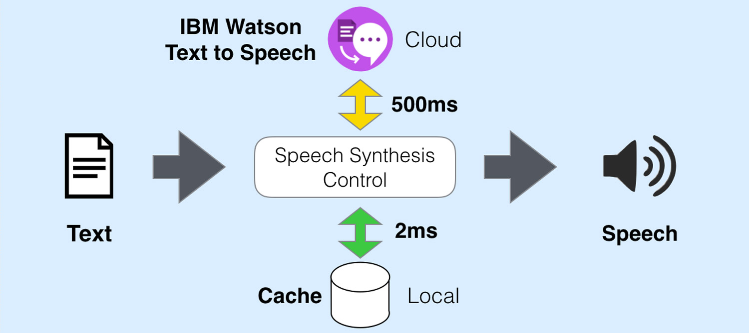
Voice chatbot
Voice Chatbot

Slide 9
Voice chatbot
What are the pros when using Voice Agent with Watson as an interface for Watson Assistant
  Easily accessible
  No download required
  Service orchestration pre-done
What are the cons when using Voice Agent with Watson as an interface for Watson Assistant
  IBM Voice Gateway (on-premises) required for some advanced features
  Intermediate flexibility
Voice Chatbot

Slide 10
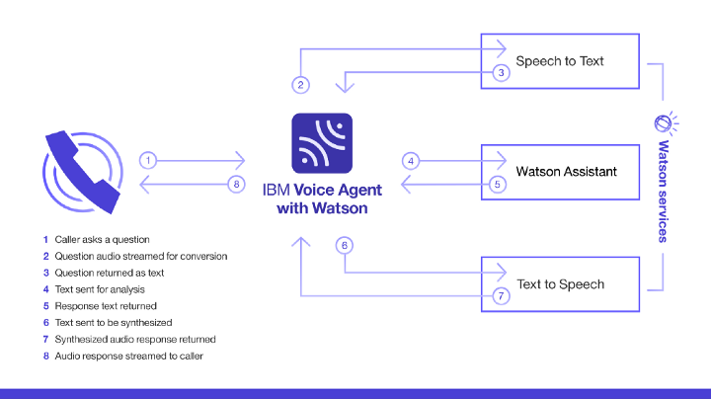
Voice chatbot
Voice Chatbot

Slide 11
Summary
Discuss the pros and cons of various voice chatbot options
Understand how Watson Speech APIs work
Voice Chatbot

Slide 12
Q & A
Voice Chatbot

